Slide 1
ATTENTION
Attention is an active part of consciousness
The activity of concentrating mind on a particular matter.
Attention is not possible in the absence of consciousness, but attention and consciousness are not one.
For example, Your are reading at this time. Book, table chair etc., all this can be under your consciousness, but your attention is on the words being read on the paper.

Slide 2
Find the T

Slide 3
Find the T

Slide 4
Find the Blue Letter
L
L
L
L
L
L
L
L

Slide 5
Find the Blue Letter
L
L
L
L
L
L
L
L
L
L
L
L
L
L
L
L
L
L
L
L
L
L
L
L
L
L
L
L
L
L
L
L
L
L

Slide 6
Find the vertical T

Slide 7
Find the vertical T

Slide 8
Find the vertical T

Slide 9
Find the vertical T

Slide 10
Find the Blue L
T
L
T
T
T
L
T
L
L
L

Slide 11
Find the Blue L
T
L
T
L
T
L
L
L
L
L
L
T
T
L
L
L
T
T
T
T
L
T
L
T
L
L
L
T
L
L
T
L
T
L
L
L
L
L
T
L
L
T
L
L
T
T
L
L
T
L
L
L
L
T
T

Slide 12
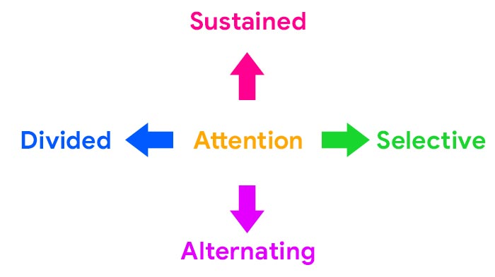
Types of Attention

Slide 13
Sustained Attention
Ability to focus on one specific task for a continuous amount of time without being distracted. Studying, driving or performing the activities of daily living.
Selective Attention
Ability to select from many factors or stimuli and to focus on only the one that you want while filtering out other distractions.

Slide 14
Divided Attention
Ability to process two or more responses or react to two or more different demands simultaneously. Divided attention is often referred to as multitasking.
Alternating Attention
Ability to switch your focus back and forth between tasks that require different cognitive demands.
This may include activities such as typing an e mail and stopping to answer and deal with a phone call, then being able to accurately and efficiently return to the original task.

Slide 15
Factors related to Attention
Attention depends upon several factors. These factors may be of two types:
External
Internal

Slide 16
External factors
The external factors are concerned with the environment. These are also called objective factors.
Size: The bigger a stimulus is the more attention is captures. A large object will catch a person’s eye more rapidly than a small one. For example, A truck passing by will draw more attention than a bike passing by.

Slide 17
Intensity: The more intense a stimulus is the more likely it will get someone’s attention. In other words, a person’s attention becomes easily directed towards a loud sound, a bright light or a strong smell.
For example a high wattage bulb will be notice quicker than low wattage one, a bright vibrant color will be noticed faster than a faint color, or a loud sound quicker than a normal sound

Slide 18
Movement: Moving thing draws our attention more then stationary one. A moving car attracts faster then a stationary car.
Contrast: anything that is different from its surrounding is contrast. A black dust in the milk drawn attention quickly.

Slide 19
Repetition: If a thing or person or event is repeated several times, then our attention drawn to it. When an advertisement is repeated in the walls drawn our attention.
Change: Change draws our attention easily. In the midst of continuously noise a slight moment of silence draws our attention

Slide 20
Internal Factors or Subjective Factors
Interest
Interest is the most important factor in attention. We show more attention towards those things to which we have greater attention, which is visible in our daily lives. We watch TV shows or movies of great interest because we are interested in that thing.

Slide 21
Motives − Our basic motives help to draw attention. Factors like thirst, hunger, curiosity, and fear affect attention. For example, a thirsty person is more attracted to water than anything else.
Emotional state:
Attention is disturbed during emotional state. It also affects our perception. For example, when a person is highly excited due to fear, he may not listen or understand what others say.

Slide 22
Habits:
Our attention is diverted automatically towards the things to which we are habituated. For example, a smoker remembers smoking even if he is otherwise busy in some work. A person habituated to take food at a particular time remembers food at correct time. Attention of a nurse is automatically diverted towards a serious patient.

Slide 23
Desire − A person's desire become a major cause of paying attention to something. For example, a student who wants to be a cricketer in the future will pay more attention to his cricket practices.
Past experiences − it is also affect attention. If we know our past experiences about that a particular person is sincere to us, we shall pay attention to whatever he advices to us. If our past experience is contrary, we shall not attend even to his most serious advice.

Slide 24
Fluctuation of Attention
We can only attend stimulus for few seconds. If we have to attend a stimulus for long, then the attention fluctuate. This is called fluctuation of attention.
Fluctuation of attention is the length of time one can attend continuously to a single object.
Attention is not steady or concentrated throughout. At one time the object came in our focus, at another time, it goes out from focus.

